Slide 1
HBIL
Horizon-Based Indirect Lighting
Notes:
(CLICK) H.B.I.L. or H-BIL is a screen-space technique to compute INDIRECT LIGHTING from the direct lighting that is present on screen.
It also computes the BENT NORMAL and the AMBIENT OCCLUSION to help sampling distance indirect lighting
We will essentially focus on the implementation details, the mathematical details can be found in my paper (I give the reference at the end).

Slide 2
Interleaved Rendering
Width
16 Slices
Height
H/4
W/4
Notes:
The screen is split into blocks of 4x4 pixels
(CLICK) You can see that all the top-left pixels of each block are rendered into that small buffer on the right which is a quarter resolution
(CLICK) That allows each pixel to reach through the entire screen because we have a very high cache coherence

Slide 3
Screen-Marching
W/4
H/4
16 Slices
Notes:
(CLICK) So for each pixel of each slice we MARCH forward and backward along only 2 ORTHOGONAL DIRECTIONS
We use at most 16 samples per direction, that’s 32 SPP total, with noise jittering to offset the positions
(CLICK) It’s important to understand that the 2 sampling DIRECTIONS DON’T CHANGE for a given slice, once again to maintain a high cache coherence
(CLICK) But we ROTATE the direction by a small angle FOR EACH DIFFERENT SLICE, all the slices together cover a rotation of 90° so that the entire disk ends up being covered

Slide 4
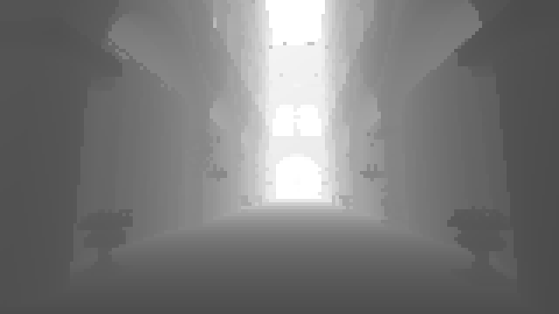
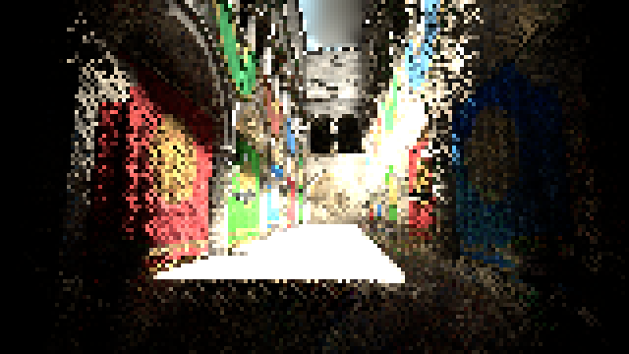
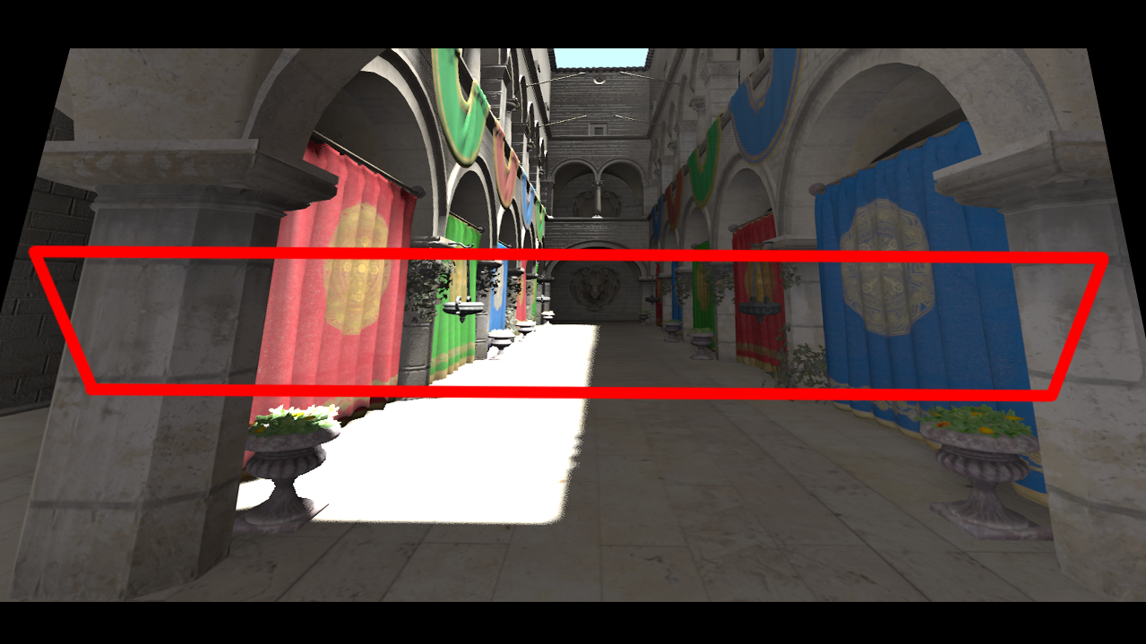
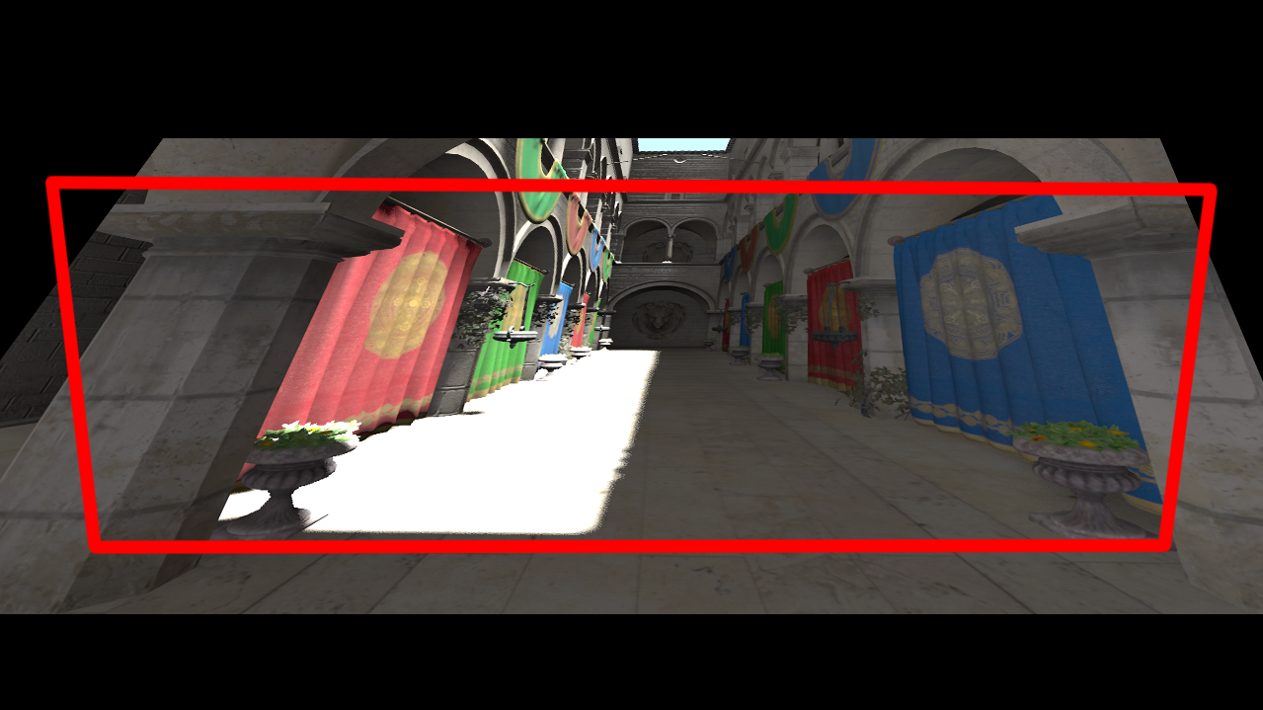
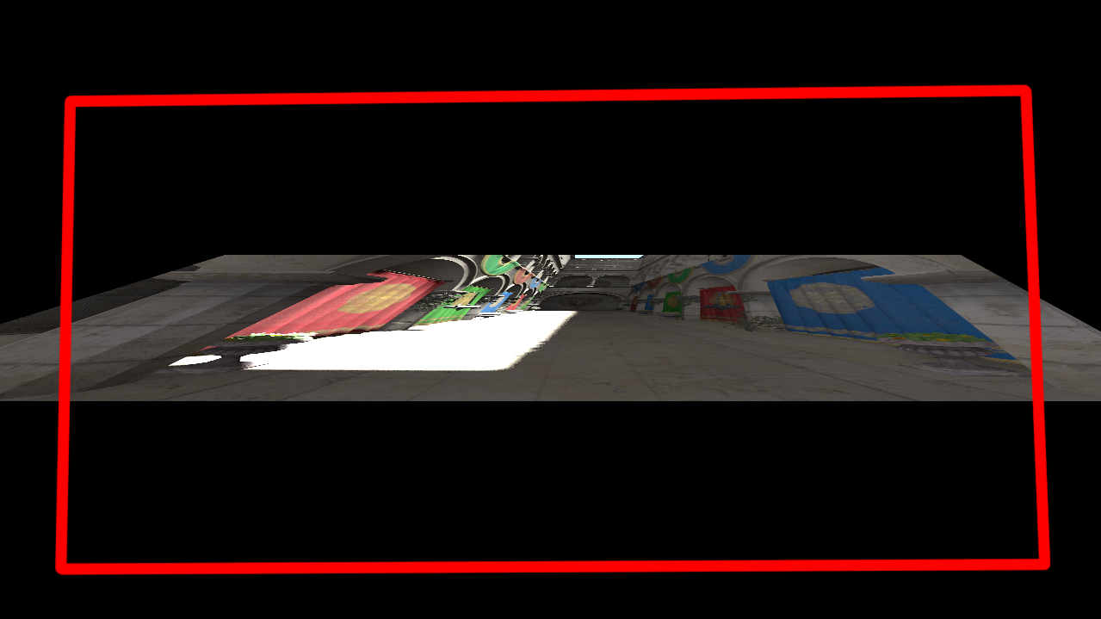
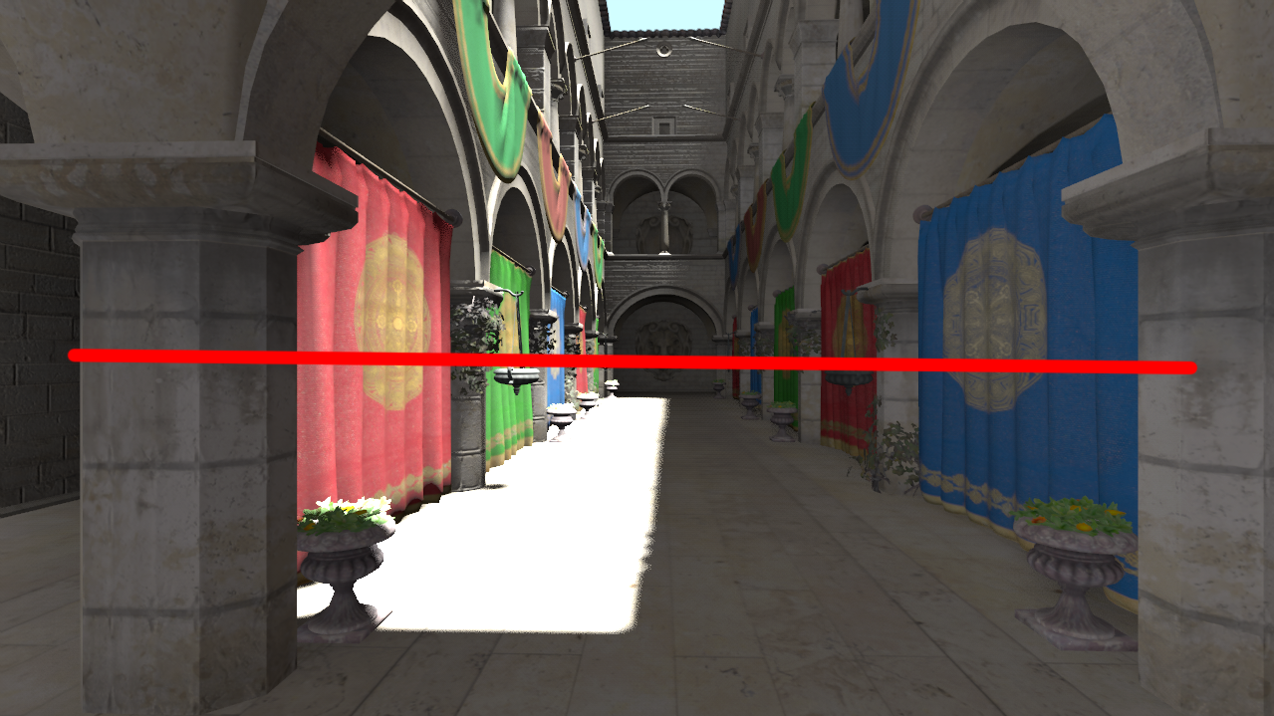
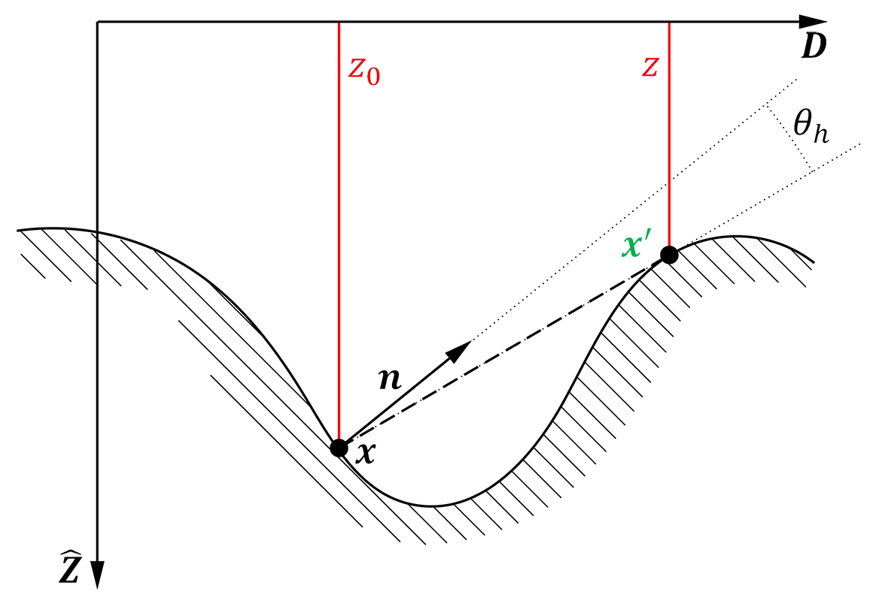
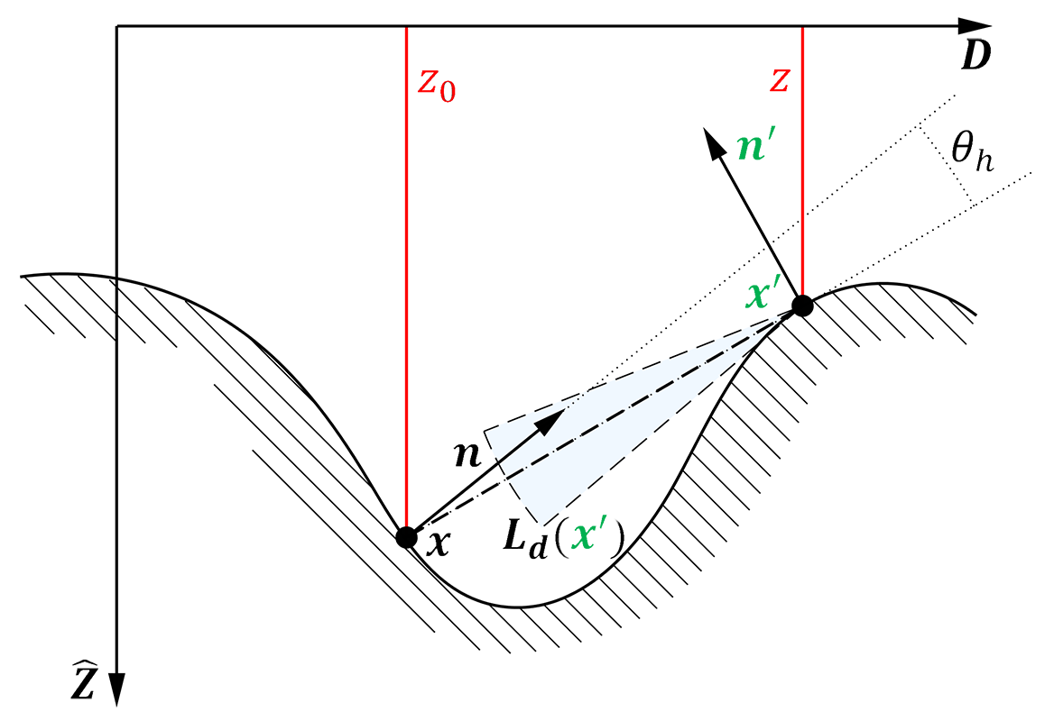
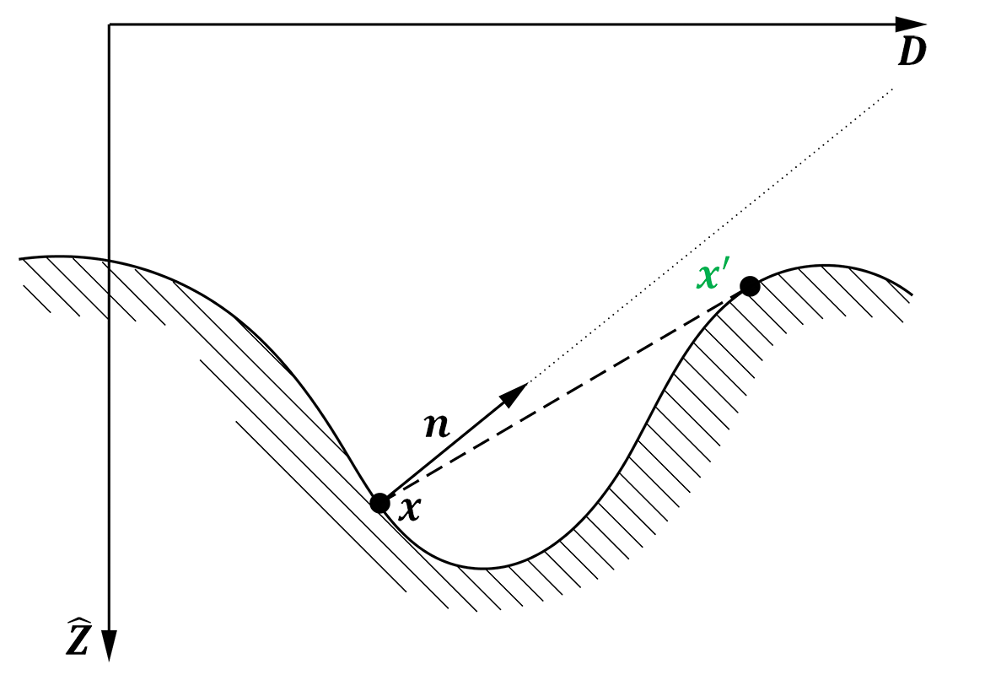
What do we Sample?
W/4
H/4
(Split) Depth
(Split) Normal
(Split) Radiance
(reprojected from last frame)
Notes:
So we are considering a SINGLE SLICE on the screen…
(CLICK) We are going to work in a side view…
Considering 1 pixel of 1 slice (keep in mind we’re doing 4x4 draw calls here)
(CLICK) So we are here, the black circle
(CLICK) We sample at the neighbor location
(CLICK) We start by sampling the depth, which helps us update the horizon angle…
(CLICK) We then sample the normal that helps us to filter out the sample, and reject it if it’s not facing our way…
(CLICK) Finally, we then sample the radiance and accumulate it

Slide 5
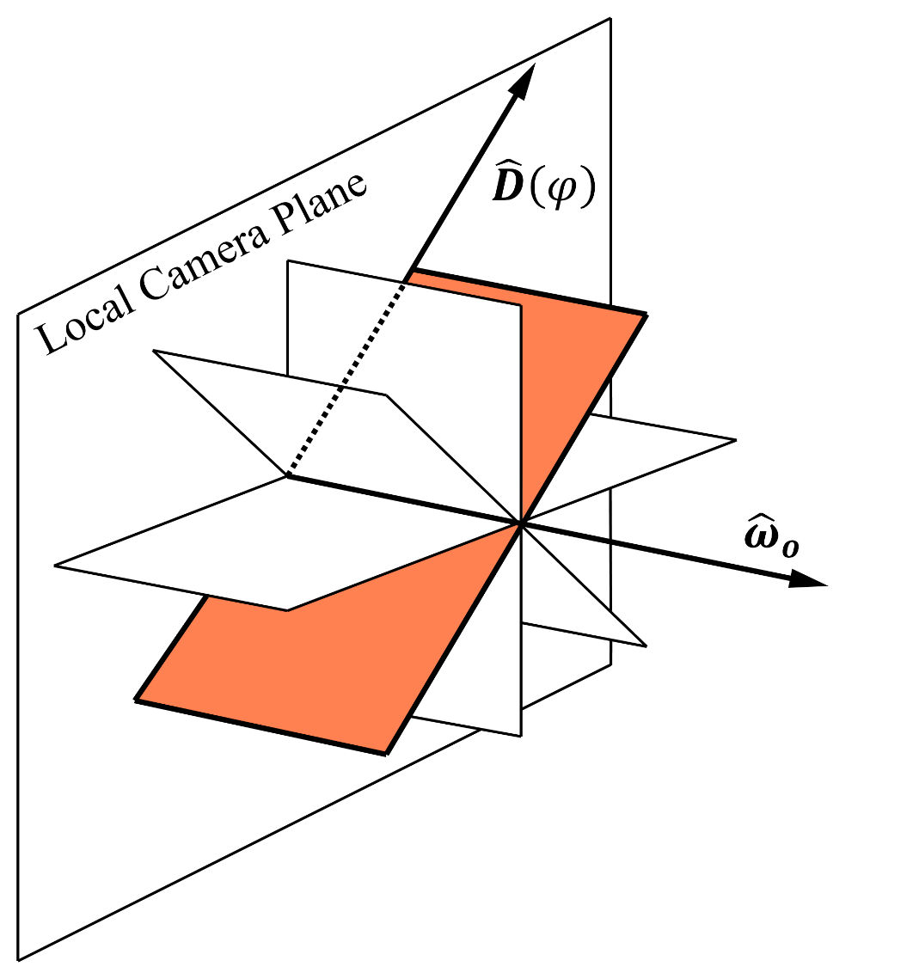
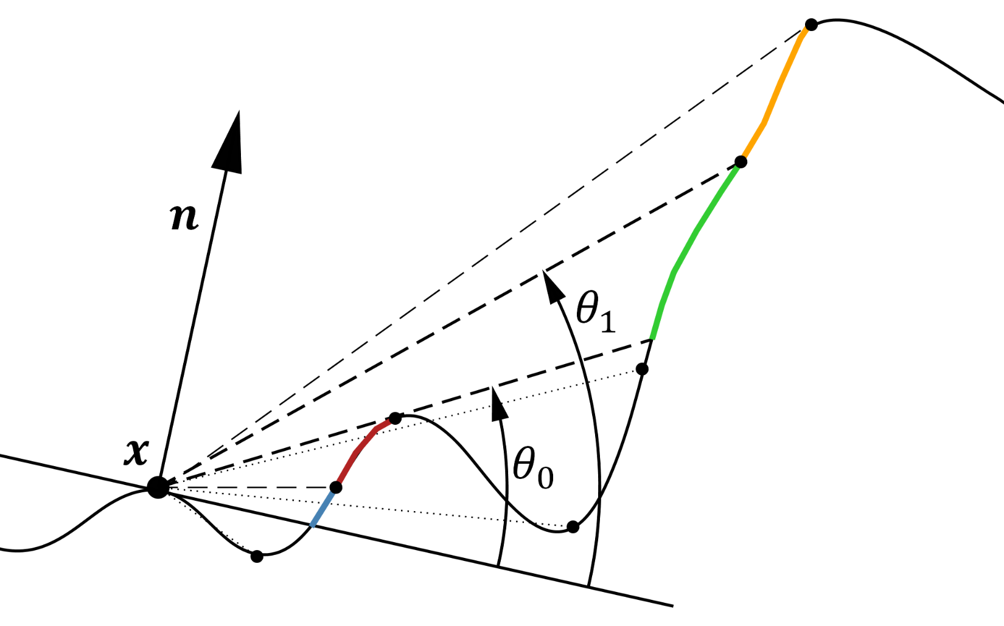
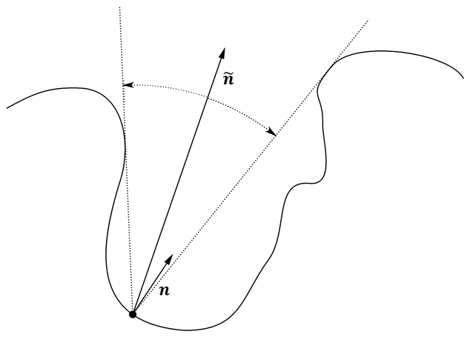
Code for my pixels, please?
At the Beginning:
For each Sample:
$$θ_{f}$$
• Accumulate
Irradiance
• Update Front & Back
Horizon Angles
At the End:
$$θ_{b}$$
• Compute Bent Normal
$$θ_{f}$$
• Compute AO
Notes:
At the beginning of the the marching loop
We start by computing the projection of the CENTRAL NORMAL (the normal of our pixel) into the onto the 2D plane we are tracing
(CLICK) Then, for each sample, we accumulate irradiance… and update the horizon angle…
(CLICK) Finally, with our front & back horizon angles, we can compute the bent normal and the ambient occlusion

Slide 6
Resulting Data
Notes:
So with the bent normal
(CLICK) The ambient occlusion
(CLICK) And the irradiance
(CLICK) We can go from this
(CLICK) To this…

Slide 7
How do we use it?
Scene by Leon Denise
DISTANT LIGHTING
Use the bent normal as sampling direction
Use the Ambient Occlusion as an aperture angle
To:
Sample pre-convolved cube map probes
Sample spherical harmonics probes
Perform voxel cone tracing
NEAR FIELD
+
=
Simply ADD the computed
Irradiance to your direct
lighting…
Notes:
So, for the FAR FIELD illumination…
(CLICK) you can USE THE BENT NORMAL as the sampling direction for the far environment lighting
(CLICK) and USE THE AMBIENT OCCLUSION as an APERTURE ANGLE so you finally get a SAMPLING CONE that you can use with various techniques like pre-convolved diffuse cube maps, SH probes or Voxel Cone Tracing
(CLICK) and for the NEAR FIELD well…
(CLICK) you simply need to add the computed irradiance to your direct lighting…

Slide 8
Conclusion
PROS
CONS
No Precomputation Required
Fast (2.5ms on a 680GTX)
No additional G-Buffer entry needed
Mathematically Correct (i.e. no double lighting)
Theoretically $∞$ light bounces
Noise (need better filtering)
Misses off screen features
Diffuse indirect lighting only
Needs additional diffuse lighting buffer
Subject to all the usual temporal and reprojection issues

Slide 9
Demo!

Slide 10
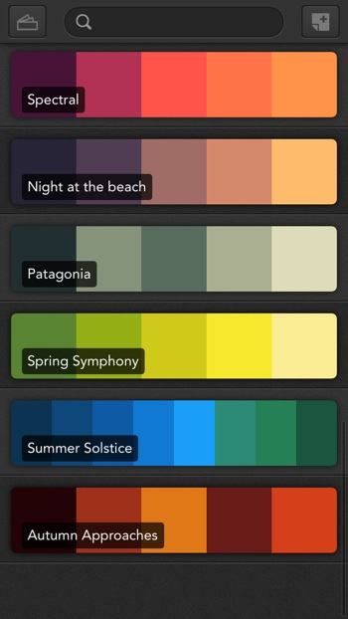
QUESTIONS?
Maybe about reprojection?
Image reconstruction?
Sample filtering?
Noise reduction?
Difference with SSRTGI?
Unification with specular SSR?
Full paper can be found on my blog: http://patapom.com/blog/
Twitter: https://twitter.com/Patapom2
Thanks to David & Géraldine, Sandra, Léon Denise and Austin Shaeffer.

